Slide 1

Computer Organization & Assembly Language
Lecture-2
Data Representation
Dr. Imtiaz Hussain
Professor
Department of Electrical and Computer Engineering
Iqra University, Karachi, Pakistan
email: imtiaz.hussain@iqra.edu.pk
Fall 2024

Slide 2
Today
Data Types
Data Representation
Data Manipulation
Exercise Problems

Slide 3
Introduction
Binary information in digital computers is stored in memory or processor registers.
Registers contain either data or control information.
Control information is a bit or a group of bits used to specify the sequence of command signals needed for manipulation of the data in other registers.
Data are numbers and other binary-coded information that are operated on to achieve required computational results.
In this lecture we present the most common types of data found in digital computers and show how the various data types are represented in binary-coded form in computer registers.

Slide 4
Introduction
The data types found in the registers of digital computers may be classified as being one of the following categories:
Numbers used in arithmetic computations
Letters of the alphabet used in data processing.
Other discrete symbols used for specific purposes.
All types of data, except binary numbers, are represented in computer registers in binary coded form.

Slide 5
Number System
A number system of base, or radix, r is a system that uses distinct symbols for r digits. Numbers are represented by a string of digit symbols.
To determine the quantity that the number represents, it is necessary to multiply each digit by an integer power of r and then form the sum of all weighted digits.
For example, the decimal number system in everyday use employs the radix 10 system.
The 10 symbols are 0, 1, 2, 3, 4, 5, 6, 7, 8, and 9. The string of digits 724.5 is interpreted to represent the quantity

Slide 6
Number System
The binary number system uses the radix 2.
The two-digit symbols used are 0 and 1.
The string of digits 101101 is interpreted to represent the quantity

Slide 7
Number System
Besides the decimal and binary number systems, the octal (radix 8) and hexadecimal (radix 16) are important in digital computer work.
The eight symbols of the octal system are 0, 1, 2, 3, 4, 5, 6, and 7.
The 16 symbols of the hexadecimal system are 0, 1, 2, 3, 4, 5, 6, 7, 8, 9, A, B, C, D, E, and F.

Slide 8
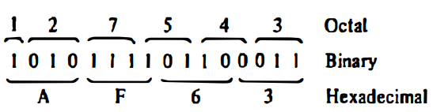
Octal and Hexadecimal Number
The conversion from and to binary, octal, and hexadecimal representation plays an important part in digital computers.
Since 2³ = 8 and 2⁴ = 16, each octal digit corresponds to three binary digits and each hexadecimal digit corresponds to four binary digits.

Slide 9
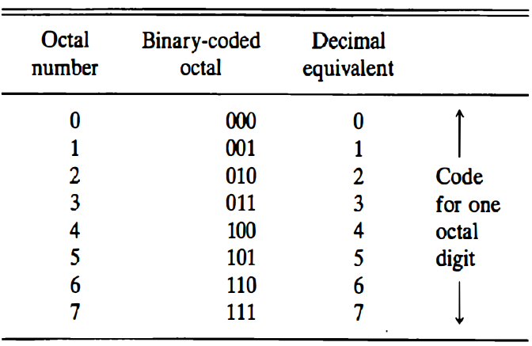
Binary Coded Octal
Binary coded octal numbers

Slide 10
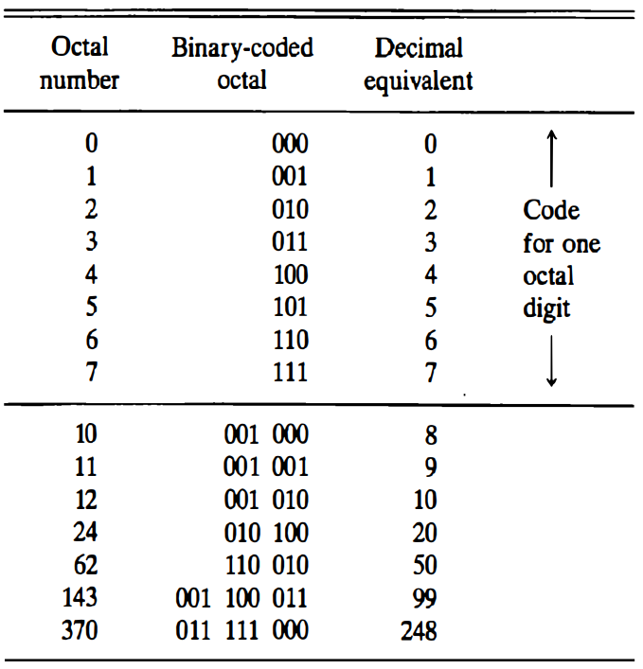
Binary Coded Octal
Binary coded octal numbers

Slide 11
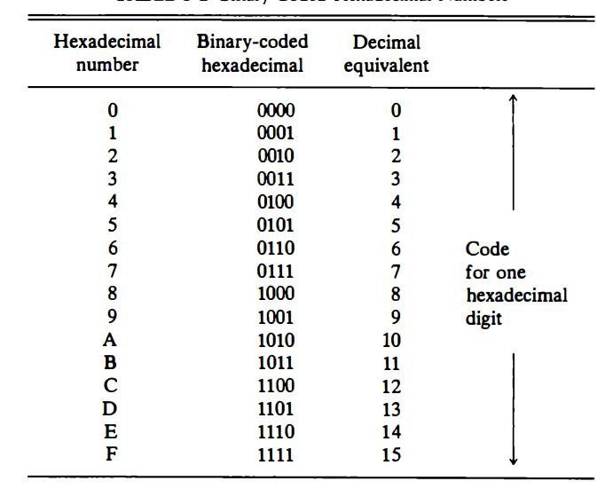
Binary Coded Hexadecimal Number
Binary coded hexadecimal numbers

Slide 12
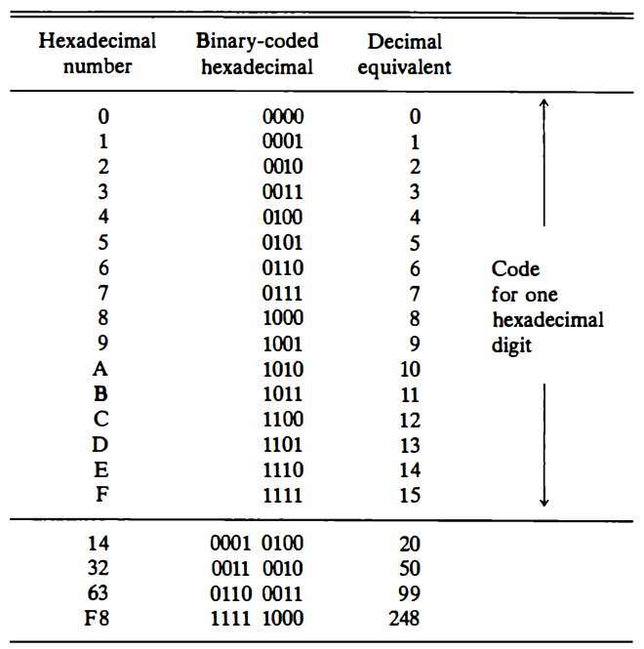
Binary Coded Hexadecimal Number
Binary coded hexadecimal numbers

Slide 13
Octal and Hexadecimal Number
The registers in a digital computer contain many bits.
Specifying the content of registers by their binary values will require a long string of binary digits.
It is more convenient to specify content of registers by their octal or hexadecimal equivalent.
The number of digits is reduced by one-third in the octal designation and by one-fourth in the hexadecimal designation.

Slide 14
Binary Coding
A binary code is a group of n bits that assume up to 2^{n} distinct combinations of 1's and 0's with each combination representing one element of the set that is being coded.
For example, a set of four elements can be coded by a 2-bit code with each element assigned one of the following bit combinations; 00, 01, 10, or 11.
A set of eight elements requires a 3-bit code, a set of 16 elements requires a 4-bit code, and so on.

Slide 15
Binary Coding
A binary code will have some unassigned bit combinations if the number of elements in the set is not a multiple power of 2.
The 10 decimal digits form such a set.
A binary code that distinguishes among 10 elements must contain at least four bits, but six combinations will remain unassigned.
Numerous different codes can be obtained by arranging four bits in 10 distinct combinations.

Slide 16
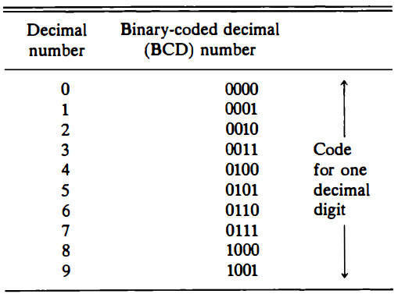
BCD
Binary coded decimal numbers

Slide 17
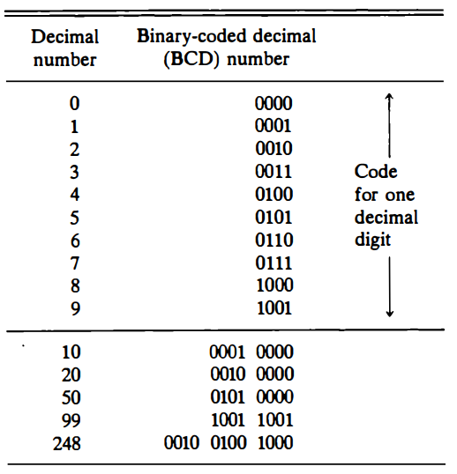
BCD
Binary coded decimal numbers

Slide 18
Alpha Numeric Representation
Many applications of digital computers require the handling of data that consist not only of numbers, but also of the letters of the alphabet and certain special characters.
An alphanumeric character set is a set of elements that includes the 10 decimal digits, the 26 letters of the alphabet and a number of special characters such as $, + , and =.
Such a set contains between 32 and 64 elements (if only uppercase letters are included) or between 64 and 128 (if both uppercase and lowercase letters are included).

Slide 19
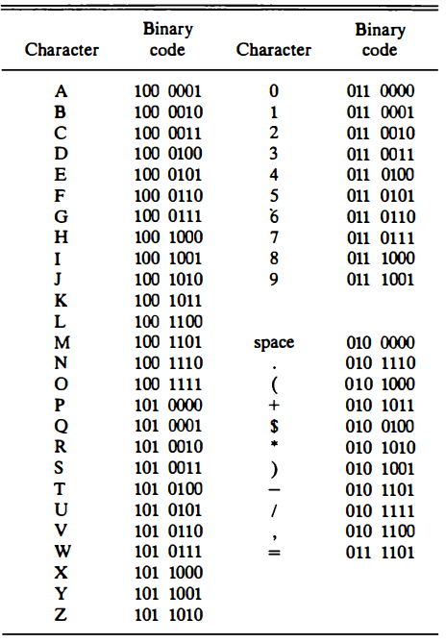
ASCII
American Standard Code for Information Interchange (ASCII)

Slide 20
Compliments
Complements are used in digital computers for simplifying the subtraction operation and for logical manipulation.
There are two types of complements for each base r system: the r's complement and the (r -1)'s complement.
When the value of the base r is substituted in the name, the two types are referred to as the 2's and 1's complement for binary numbers and the 10's and 9's complement for decimal numbers.

Slide 21
(r-1)’s Compliments
The 9's complement of a decimal number is obtained by subtracting each digit from 9.
For example, the 9's complement of 546700 is 999999 - 546700 = 453299
The 9's complement of 12389 is 99999 - 12389 = 87610

Slide 22
(r-1)’s Compliments
The 1's complement of a binary number is obtained by subtracting each digit from 1.
However, the subtraction of a binary digit from 1 causes the bit to change from 0 to 1 or from 1 to 0.
Therefore, the 1's complement of a binary number is formed by changing 1's into 0's and 0's into 1’s.
For example, the 1's complement of 1011001 is 0100110 and the 1' s complement of 0001111 is 1 110000.

Slide 23
r’s Compliments
r's complement is obtained by adding 1 to the (r-1)'s complement.
The 10's complement of the decimal 2389 is 7610 +1 = 7611 and is obtained by adding 1 to the 9' s complement value.
The 2's complement of binary 101100 is 010011 + 1 = 010100 and is obtained by adding 1 to the 1's complement value.

Slide 24
r’s Compliments
The 2's complement can be formed by leaving all least significant 0's and the first 1 unchanged, and then replacing 1's by 0's and 0's by 1's in all other higher significant bits.
The 2's complement of 1101100 is 0010100 and is obtained by leaving the two low-order 0's and the first 1 unchanged, and then replacing 1's by 0's and 0's by 1's in the other four most significant bits.

Slide 25
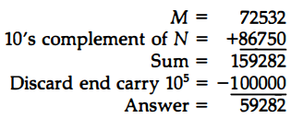
Subtraction
Consider the subtraction 72532 - 13250 = 59282.
The 10's complement of 13250 is 86750.
Therefore

Slide 26
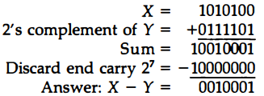
Subtraction
Subtraction with complements is done with binary numbers in a similar manner using the same procedure outlined above.
Using the two binary numbers X = 1010100 and Y = 1000011, we perform the subtraction X – Y using 2's complements:

Slide 27
Fixed Point Representation
Positive integers, including zero, can be represented as unsigned numbers.
However, to represent negative integers, we need a notation for negative values.
Because of hardware limitations, computers must represent everything with 1's and 0's, including the sign of a number.
As a consequence, it is customary to represent the sign with a bit placed in the leftmost position of the number.

Slide 28
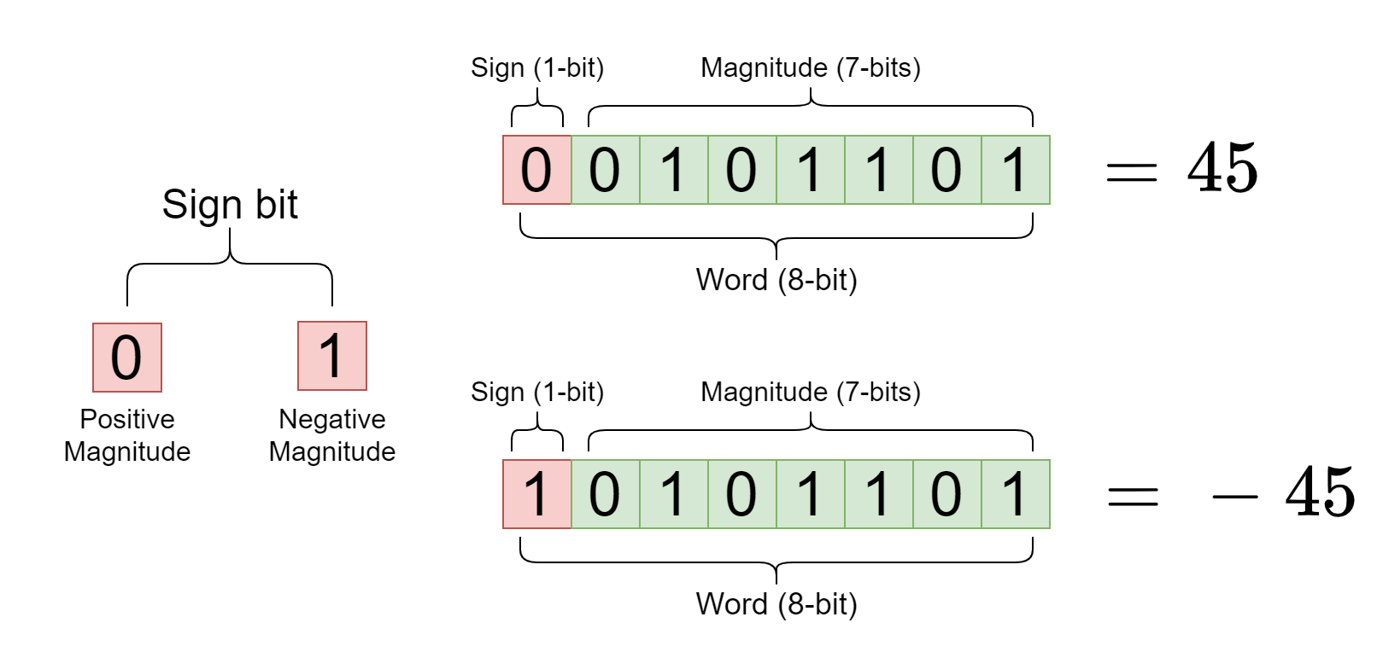
Fixed Point Representation
The convention is to make the sign bit equal to 0 for positive and to 1 for negative.

Slide 29
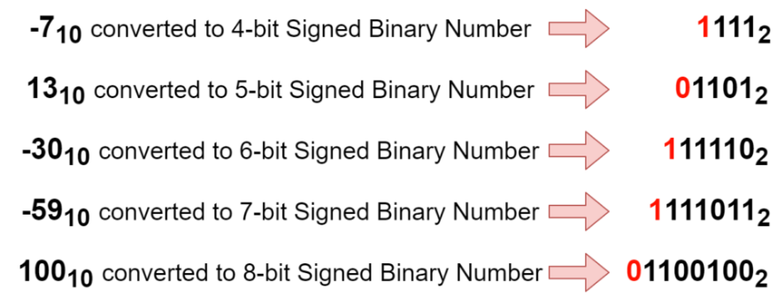
Fixed Point Representation
Examples

Slide 30
Fixed Point Representation
In addition to the sign, a number may have a binary (or decimal) point.
There are two ways of specifying the position of the binary point in a register:
Fixed point
Floating-point

Slide 31
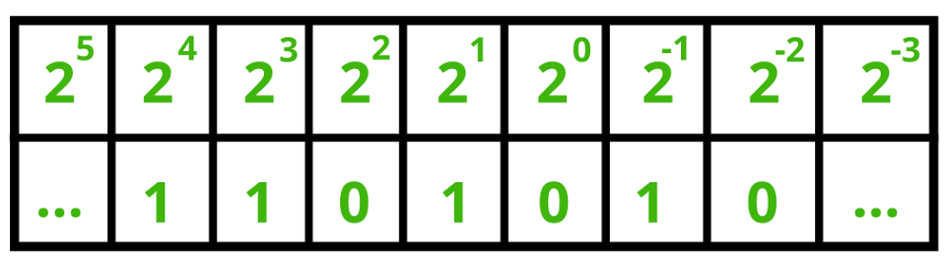
Fixed Point Representation
In Fixed Point
11010.1₂ = 1 * 2⁴ + 1 * 2³ + 0 * 2² + 1 * 2¹ + 0* 2⁰ + 1 * 2⁻¹
= 16 + 8 + 2 + 0.5
= 26.5

Slide 32
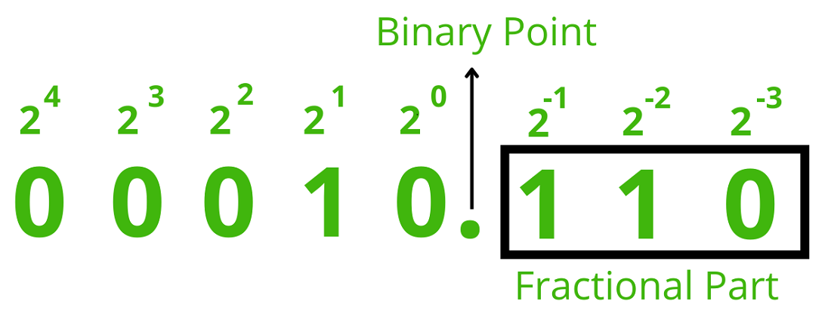
Fixed Point Representation
In Fixed Point
00010.110₂ = =1 * 2¹ + 1 * 2⁻¹ + 1 * 2⁻²
= 2 + 0.5 + 0.25
= 2.75

Slide 33
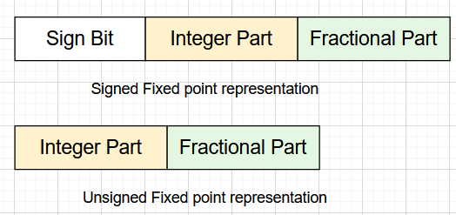
Fixed Point Representation
Sign bit:- The fixed-point number representation in binary uses a sign bit.
Integral Part:- The integral part in fixed-point numbers is of different lengths at different places. It depends on the register's size; for an 8-bit register, the integral part is 4 bits.
Fractional part:- The Fractional part is of different lengths at different places. It depends on the registers; for an 8-bit register, the fractional part is 3 bits.

Slide 34
Fixed Point Representation
Size of Sign Bit, Integer Part, and Fractional Part for different registers are displayed below:
Register | Sign Bit | Integer Part | Fraction Part
8- bit Register | 1 bit | 4 bits | 3 bits
16- bit Register | 1 bit | bits | 6 bits
32- bit Register | 1 bit | 15 bits | 16 bits

Slide 35
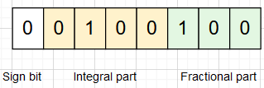
Fixed Point Representation
Example: The number considered is 4.5
Step 1: We will convert the number 4.5 to binary form. 4.5 = 100.1

Slide 36
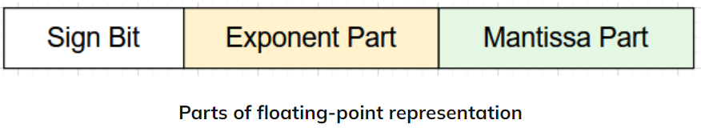
Floating Point Representation
Floating Point representation doesn't reserve any specific number of bits for the integer or fractional parts.
It reserves certain bits for the number (called the significand or mantissa) and a fixed number of bits to say where the decimal place lies (called the exponent).

Slide 37
Floating Point Representation
Sign bit:- A negative number has a sign bit 1, while a positive number has a sign bit 0. The sign of any number depends on mantissa, not on exponent.
Mantissa Part:- The mantissa part is of different lengths at different places. It depends on registers like for a 16-bit register, and mantissa part is of 8 bits.
Exponent Part:- It is the power of the number. It depends on the size of the register. For example, in the 16-bit register, the exponent part is of 7 bits.

Slide 38
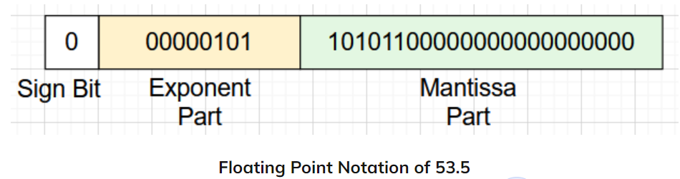
Floating Point Representation
Example: The number considered is 53.5
Step 1: We will convert the number 53.5 to binary form. 53.5 = 110101.1
Step 2: Normalize the number ( base is 2) = (1.101011) * 2⁵.
Step 2: Represent the binary number in floating-point notation with the following format (32 bit).

Slide 39
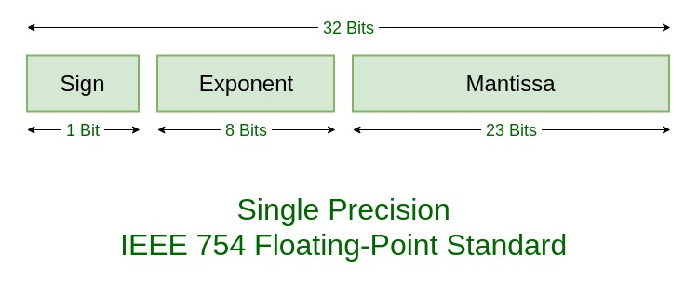
IEEE Standard for Floating-Point Arithmetic (IEEE 754)
It is a technical standard for floating-point computation which was established in 1985 by the Institute of Electrical and Electronics Engineers (IEEE).
IEEE Standard 754 floating point is the most common representation today for real numbers on computers, including Intel-based PC’s, Macs, and most Unix platforms.

Slide 40
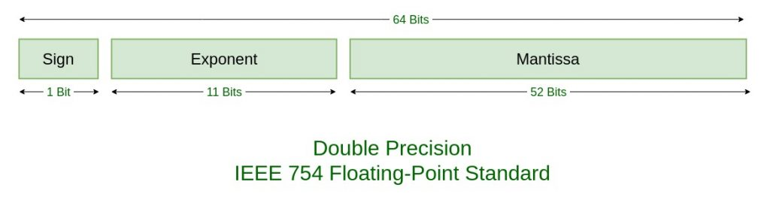
IEEE Standard for Floating-Point Arithmetic (IEEE 754)
It is a technical standard for floating-point computation which was established in 1985 by the Institute of Electrical and Electronics Engineers (IEEE).
IEEE Standard 754 floating point is the most common representation today for real numbers on computers, including Intel-based PC’s, Macs, and most Unix platforms.

Slide 41
Exercise Problems
Show the value of all bits of a 12-bit register that hold the number equivalent to decimal 215 in (a) binary (b) binary-coded octal (c) binary coded hexadecimal (d) binary coded decimal (BCD).
Decode the following ASCII code:
1001010 1001111 1001000 1001110 0100000 1000100 1001111 1000101

Slide 42
Exercise Problems
Obtain the 9's complement of the following eight-digit decimal numbers:
12349876; 00980100; 90009951; and 00000000.
Obtain the 10's complement of the following six-digit decimal numbers:
123900; 090657; 100000; and 000000.
Obtain the 1's and 2's complements of the following eight-digit binary numbers
10101110; 10000001; 10000000; 00000001; and 00000000.

Slide 43
Exercise Problems
Perform the arithmetic operations (+42) + (-13) and (-42) -(-13) in binary using signed-2's complement representation for negative numbers.
Represent the number (+46.5)₁₀, as a floating-point binary number with 24 bits. The normalized fraction mantissa has 16 bits and the exponent has 8 bits.

Slide 44
End of Lecture-2

